Slide 1
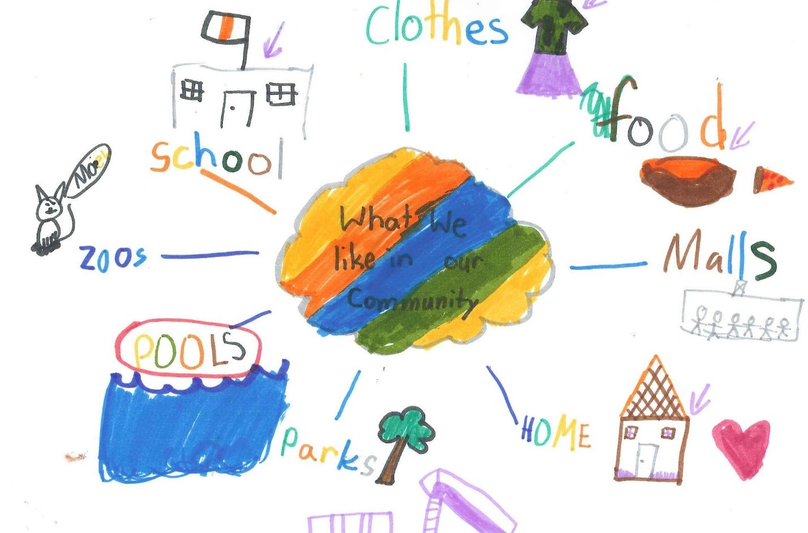
The Right to Be Heard and Express Yourself
Burnaby Charter Action Plan
2021

Slide 2
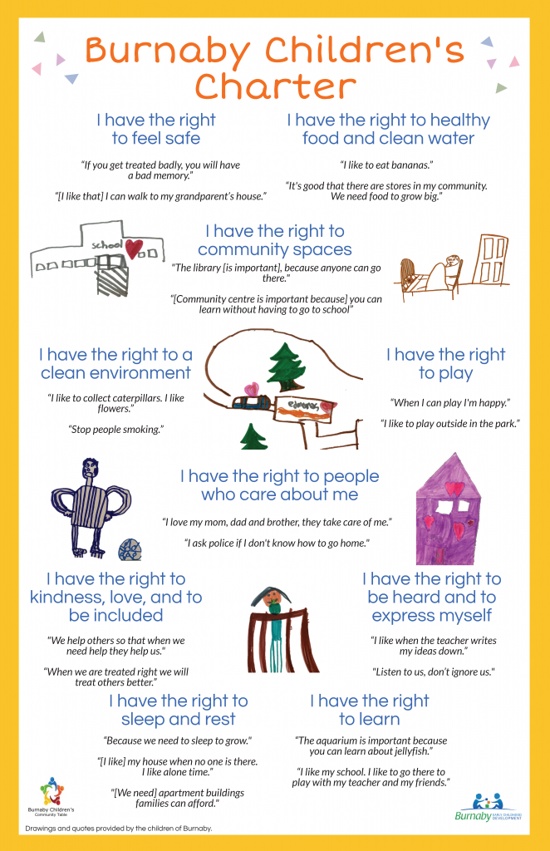
The Burnaby Children’s Charter was developed in 2019 and included the voices of 250 children across Burnaby.
The Charter was developed by the Burnaby Children’s Community table in partnership with Equitas and is now in the action planning stage, with multiple agencies having endorsed the Charter.
This presentation is part of a year-long series where we will highlight the rights of the Charter each month and is intended for adults who work with children and youth.

Slide 3
A few quotes gathered from children during the Charter creation process:
“I like when the teacher writes my ideas down”
“Listen to us, don’t ignore us.”

Slide 4
Explaining the Right
Children had many recommendations for adults. They shared the need to feel heard, loved and supported by adults. They also expressed the importance of play and choice.
Children have the right to be heard and express themselves in any way available to them. Adults have a responsibility to listen to children and take them seriously.

Slide 5
Questions to think about or discuss:
What are you seeing in the community in relation to this right?
As an adult supporting children, what is your responsibility to this right?
What strategies do you currently implement to foster environments where children feel safe to express themselves and to share their ideas and opinions?

Slide 6
Best Practice
In regards to protecting and promoting the rights of children, adults can consider a child’s best interests when making decisions that affect them
Before making decisions, adults can consult children on their ideas, concerns, opinions and questions
Adults can be transparent with children and explain the reason for decisions
Adults can also incorporate choice and free play into their schedule, as requested by children through the Charter process

Slide 7
For more information:
Suzanne Vardy - Suzanne.Vardy@burnabyschools.ca
Safe and Caring Schools Team - Burnaby School District
Sheri Brattston - Sheri.brattston@burnabyschools.ca
Managing Director, Community Education - Burnaby School District
Gabriella Maio - Gabriella.Maio@gov.bc.ca
Community Development Worker - Ministry of Children and Family Development

