Slide 1
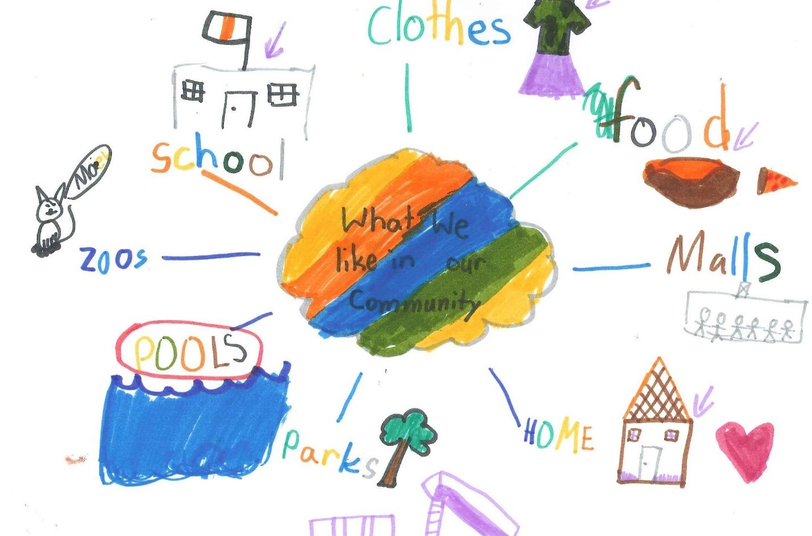
Right to Healthy Food and Clean Water
Burnaby Charter Action Plan
March 2022

Slide 2
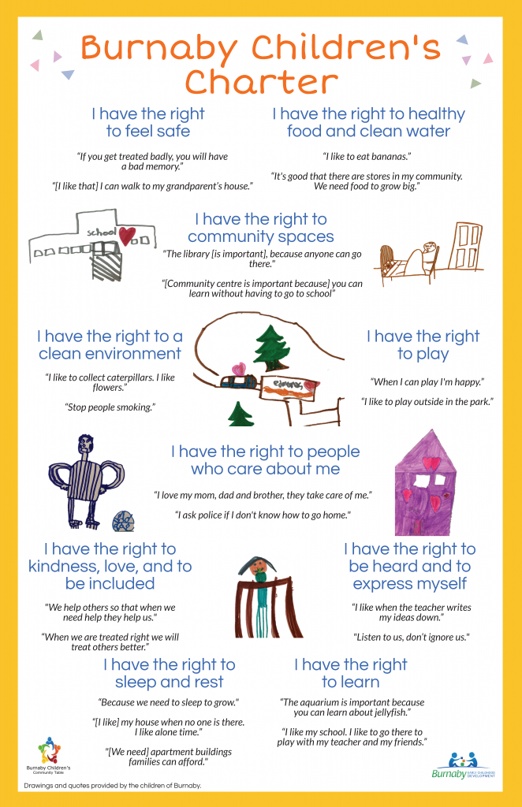
The Burnaby Children’s Charter was developed in 2019 and included the voices of 250 children across Burnaby.
The Charter was developed by the Burnaby Children’s Community table in partnership with Equitas and is now in the action planning stage, with multiple agencies having endorsed the Charter.
This presentation is part of a year-long series where we will highlight the rights of the Charter each month and is intended for adults who work with children and youth.

Slide 3
A few quotes gathered from children during the Charter creation process:
“I like to eat bananas.”
“It’s good that there are stores in my community. We need food to grow big.”

Slide 4
Explaining the Right
During the Charter process, children brought up their desire to have healthy food options available to them at home and in the community. They mentioned places that make them feel connected in their community, which include grocery stores or ice cream shops.
They frequently shared that they believe healthy food and clean water are things that help them grow up happy and healthy.

Slide 5
Questions to think about or discuss:
What are you seeing in the community in relation to this right?
As an adult supporting children, what is your responsibility to this right?
What practices, if any, do you currently implement in regards to this right (for example, offering snacks or meals)?

Slide 6
Best Practice
After school programs / child and youth serving agencies are an important provider of healthy, nutritious food for children
Empower children by offering a choice between 2 or more snacks (if possible) and encourage children to try a variety of foods
It can also help to educate children on diversity of food culture to cultivate understanding and acceptance

Slide 7
For more information:
Suzanne Vardy - Suzanne.Vardy@burnabyschools.ca
Safe and Caring Schools Team - Burnaby School District
Sheri Brattston - Sheri.brattston@burnabyschools.ca
Managing Director, Community Education - Burnaby School District
Gabriella Maio - Gabriella.Maio@gov.bc.ca
Community Development Worker - Ministry of Children and Family Development

