Slide 1
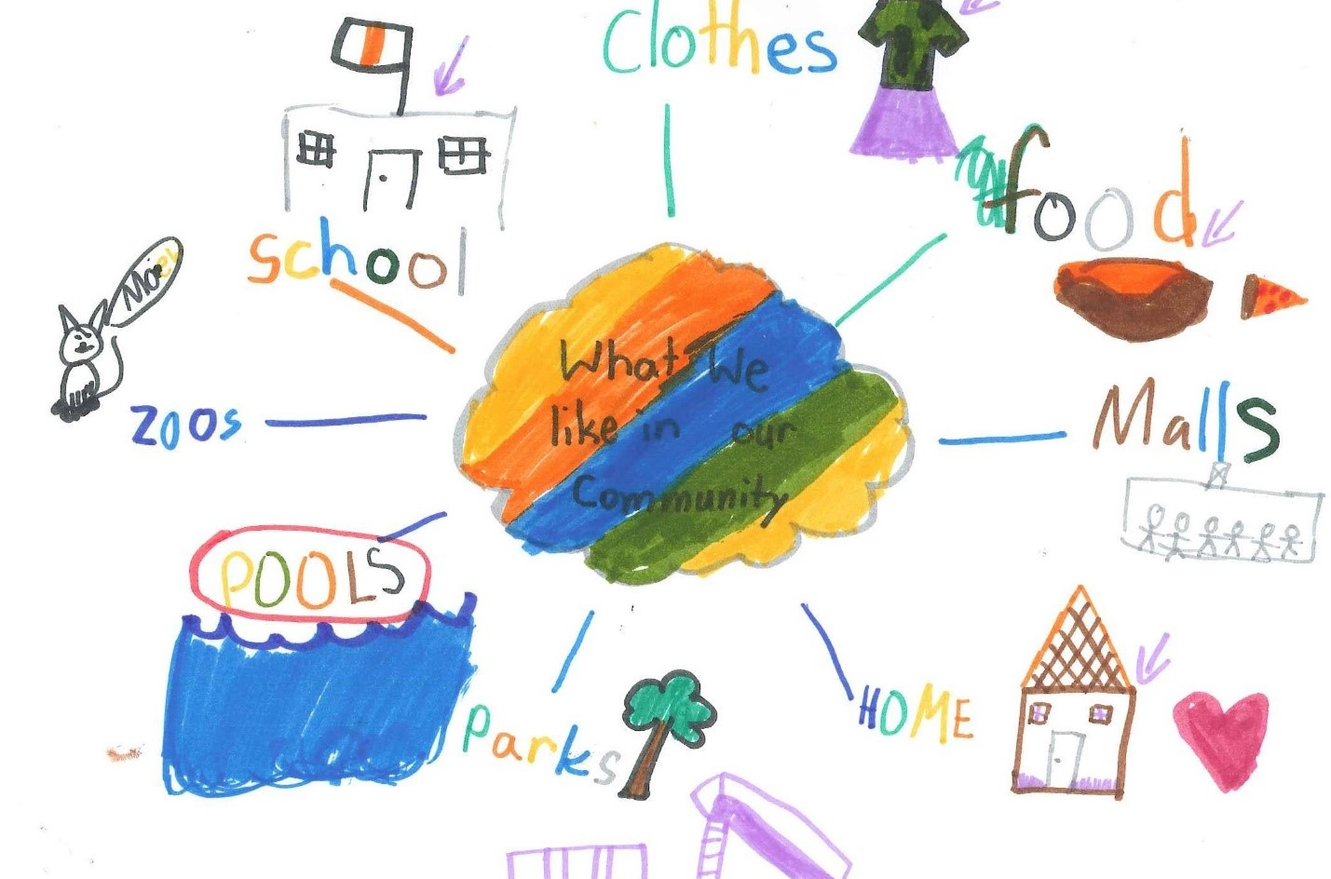
Right to feel safe and the right to kindness, love, and to feel included
Burnaby Charter Action Plan
January/February 2022

Slide 2
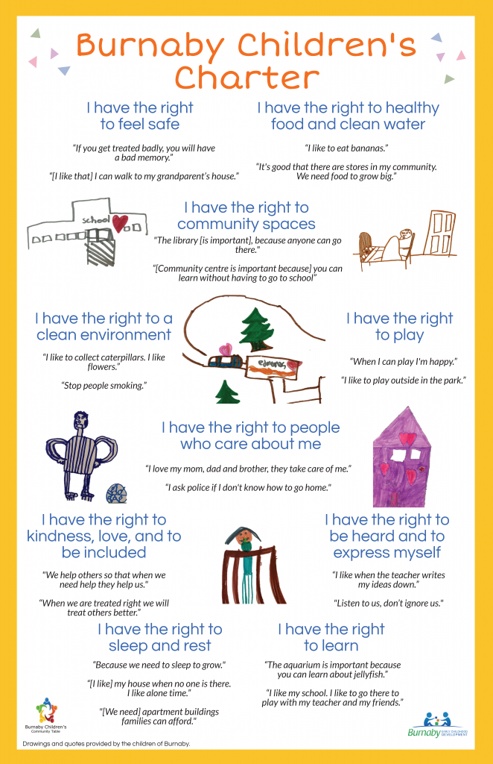
The Burnaby Children’s Charter was developed in 2019 and included the voices of 250 children across Burnaby.
The Charter was developed by the Burnaby Children’s Community table in partnership with Equitas and is now in the action planning stage, with multiple agencies having endorsed the Charter.
This presentation is part of a year-long series where we will highlight the rights of the Charter each month and is intended for adults who work with children and youth.

Slide 3
A few quotes gathered from children during the Charter creation process:
“If you get treated badly, you will have a bad memory”
“[I like that] I can walk to my grandparents house”
“We help others so that when we need help they help us”
“When we are treated right we will treat others better”

Slide 4
Explaining the Right
Children had many suggestions for how adults can make them feel safe, loved and included in community life. Children spoke about how play, healthy food, active listening, and choice are all things adults can do to show children they care.
Children also expressed the need for peer acceptance and inclusion and how it felt good to have friends and adults treat each other with kindness.

Slide 5
Questions to think about or discuss:
What are you seeing in the community in relation to the right to feel safe? What are you seeing in relation to the right to kindness, love, and inclusion?
As an adult supporting children, what is your responsibility to the right to safety? To the right to inclusion?
What strategies do you currently implement to foster environments where children feel safe to explore new friendships or to participate?

Slide 6
Best Practice
Feeling safe and being safe have different meanings
As adults, we implement many strategies to ensure the physical and mental safety of children in our care
Think about what measures you have in place that allow children to feel safe to express themselves, to learn new things or to make new friends
All children are entitled to respect and kindness from their peers and adults in their sphere
A child who feels safe will feel free to build healthy relationships and thus feel more included in their communities

Slide 7
For more information:
Suzanne Vardy - Suzanne.Vardy@burnabyschools.ca
Safe and Caring Schools Team - Burnaby School District
Sheri Brattston - Sheri.brattston@burnabyschools.ca
Managing Director, Community Education - Burnaby School District
Gabriella Maio - Gabriella.Maio@gov.bc.ca
Community Development Worker - Ministry of Children and Family Development

