Slide 1
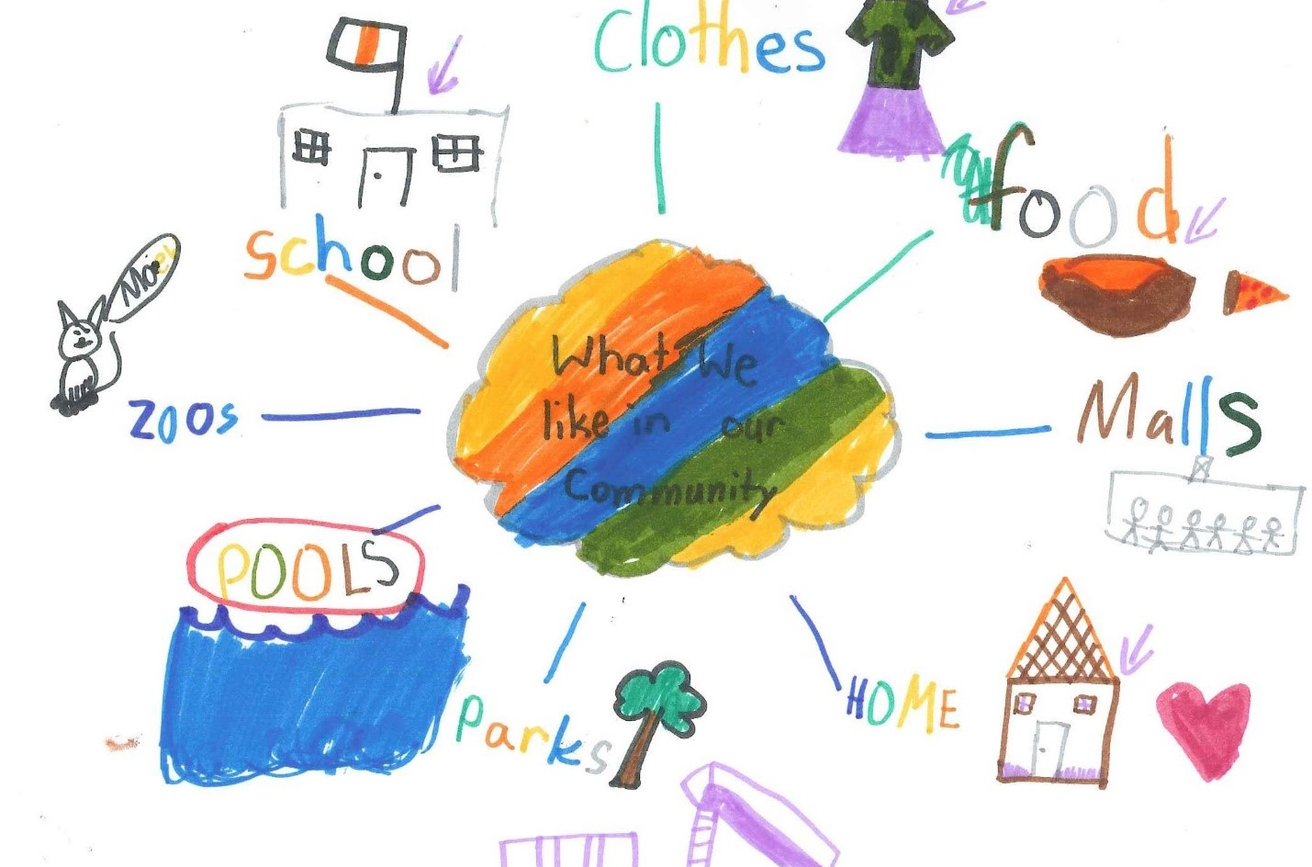
The Right to a Clean Environment
Burnaby Charter Action Plan
2021

Slide 2
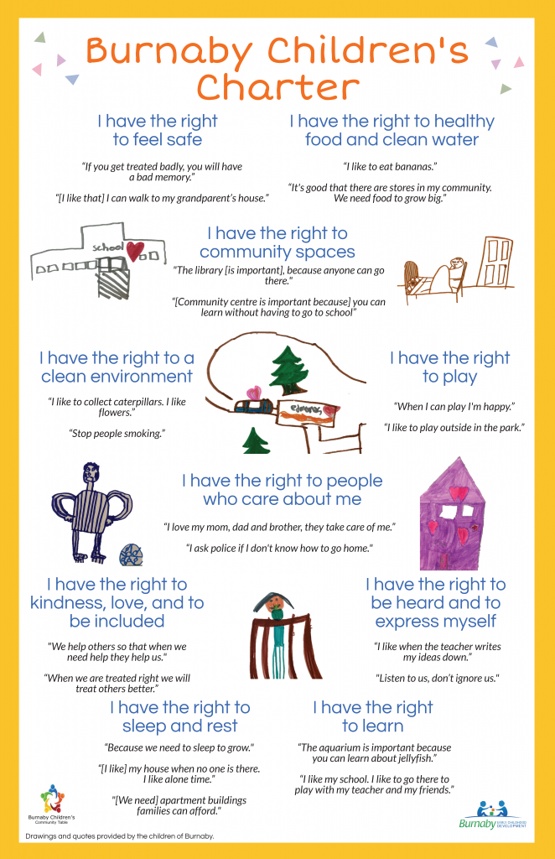
The Burnaby Children’s Charter was developed in 2019 and included the voices of 250 children across Burnaby.
The Charter was developed by the Burnaby Children’s Community table in partnership with Equitas and is now in the action planning stage, with multiple agencies having endorsed the Charter.
This presentation is part of a year-long series where we will highlight the rights of the Charter each month and is intended for adults who work with children and youth.

Slide 3
A few quotes gathered from children during the Charter creation process:
“I like to collect caterpillars. I like flowers.”
“Stop people smoking”

Slide 4
Explaining the Right
Chi
Children expressed their appreciation for being outside in nature and enjoying the clean air. They like that their communities have parks and trees.
Children mentioned smoking, vaping and pollution as activities they do not like in their communities. They want adults to know so they can help contribute to making the air cleaner.

Slide 5
Questions to think about or discuss:
1.
What are you seeing in the community in relation to this right?
As an adult supporting children, what is your responsibility to this right?
In what ways can we make program spaces a clean environment for children?

Slide 6
Best Practice
We may not have as much control over things like smoking or pollution in our program spaces, however we can still find ways to highlight this right with children we serve
By including children in helping to create a clean environment, we are bringing awareness to this right
Include children in tidying your space, practice frequent hand washing, and discuss what nature (parks, trees) mean to you as a group

Slide 7
For more information:
Suzanne Vardy - Suzanne.Vardy@burnabyschools.ca
Safe and Caring Schools Team - Burnaby School District
Sheri Brattston - Sheri.brattston@burnabyschools.ca
Managing Director, Community Education - Burnaby School District
Gabriella Maio - Gabriella.Maio@gov.bc.ca
Community Development Worker - Ministry of Children and Family Development

